Slide 1
LionWeb:
Status +
Delta Protocol
LangDev 2025
Meinte Boersma, Niko Stotz, Ulyana Tikhonova

Slide 2

Status

Slide 3
Mission
Adopt language engineering
Reduce vendor lock-in
Mix and match components
Foster innovation and incremental improvements
To create an ecosystem of interoperable components for building language-oriented modeling tools on the web.

Slide 4
Reference Architecture
Clients
Editors
  Visual
  Projectional
B
C
F
A
✓
G
1
G
Processors
  Model checker
  Importer
  Generator
D
2
C
F
D
✓
E
✓
Repository
Models
  Original
  Derived
E
Protocols (bulk / delta )
Contents (JSON / Protobuf )
✓
✓
✓
A
✓
✓
✓
B

Slide 5
Talks
  LangDev 2023 (slides, video)
  LangDev 2024 (slides, video)
  SEN Symposium 2024 (conference, slides)
  MODELS 2024 (conference)
  MBSE 2025 (conference)
Working documents
  Roadmap
  Reference architecture
  Use cases

Slide 6
Other talks about LionWeb @ LangDev 25
Title | Speaker | Affiliation
Protostar: an AST solution for ANTLR4 and LionWeb Thursday 9:30 | Alessio Stalla | Strumenta
LionWeb’s delta protocol: incremental model changes Thursday 15:00 | Meinte Boersma, Niko Stotz | DSL Consultancy, F1RE
Making DSLs conversable Thursday 15:30 | Krishna Narasimhan | F1RE
Freon-Powered: Crafting Web-Native DSL Editors That Wow Thursday 17:00 | Jos Warmer | OpenModeling
SysML v2 language in LionWeb Friday 10:10 | Ulyana Tikhonova | F1RE

Slide 7
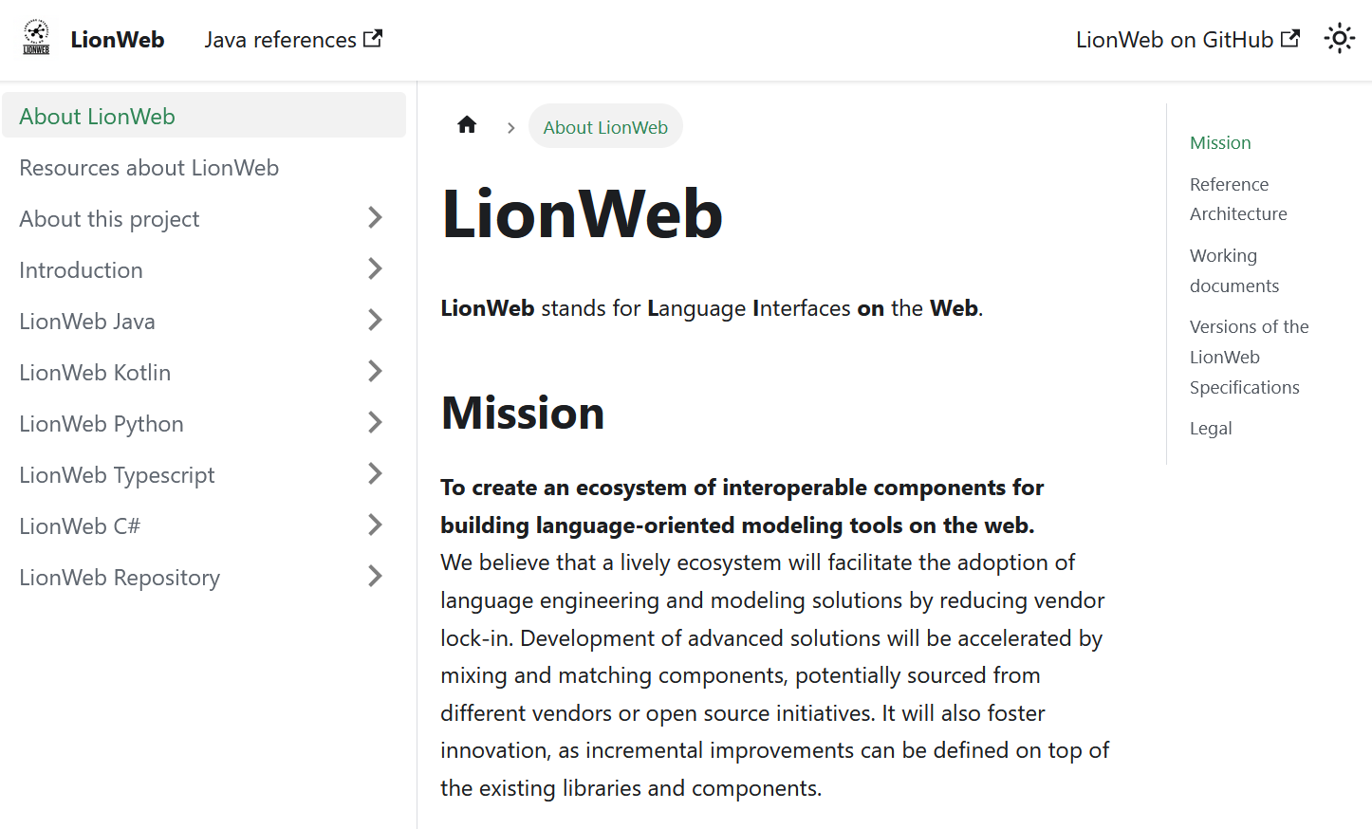
Better documentation
lionweb.io

Slide 8
Better outreach
New core members
  Pedro Molina / Metadev
  Ulyana Tikhonova, Erkan Diken / F1RE
Office hours
  Once a month (every second Friday)

Slide 9
Delta protocol

Slide 10
Basic idea
Editor A
Repository
Processor C
Editor B
  Assumption: Every client starts from same model state
  1. Editor A sends command ChangeProperty to Repository
  2. Repository checks and integrates command
  3. Repository sends event PropertyChanged to all clients
  4. Editor B sends query SignOn to Repository
  5. Editor B sends query SubscribeToPartitionContents to Repository, receives partition contents

Slide 11
Message kinds
Command | Client ⇨ Repository | Async | “I want to change this”
Event | Client ⇦ Repository | Async | “This changed”
Query | Client ⬄ Repository | Synchronous | “Tell me about this”

Slide 12
All commands
Action |  | Child | Annotation | Reference | Property | Partition / Classifier
Add |  | Add child | Add annotation | Add reference Add reference ResolveInfo Add reference target | Add property | Add partition
Delete |  | Delete child | Delete annotation | Delete reference Delete reference ResolveInfo Delete reference target | Delete property | Delete partition
Change |  | Replace child | Replace annotation | Change reference Change reference ResolveInfo Change reference target | Change property | Change classifier
Move | from other node | Move child from other containment | Move annotation from other parent | Move entry from other reference
 | from other feature in same node | Move child from other containment in same parent |  | Move entry from other reference in same parent
 | in same feature in same node | Move child in same containment | Move annotation in same parent | Move entry in same reference
Move and replace existing | from other node | Move child from other containment and replace existing child | Move annotation from other parent and replace existing annotation | Move entry from other reference and replace existing entry
 | from other feature in same node | Move child from other containment in same parent and replace existing child |  | Move entry from other reference in same parent and replace existing entry
 | in same feature in same node | Move child in same containment and replace existing child | Move annotation in same parent and replace existing annotation | Move entry in same reference and replace existing entry
Composite |  | Composite

Slide 13
All queries
Subscription
  Subscribe to partition changes
  Subscribe to partition contents
  Unsubscribe from partition contents
Participation
  Sign On
  Sign Off
  Reconnect
Miscellaneous
  Get available ids
  List partitions

Slide 14
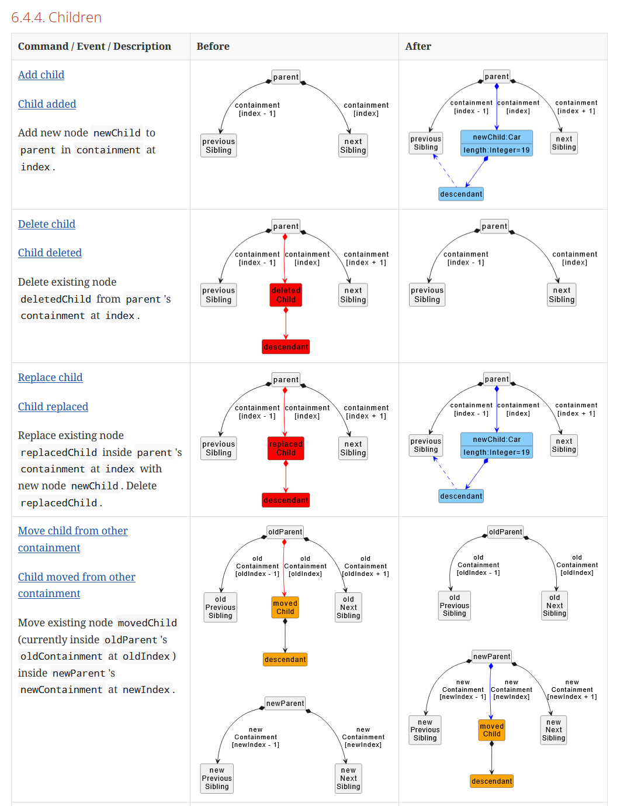
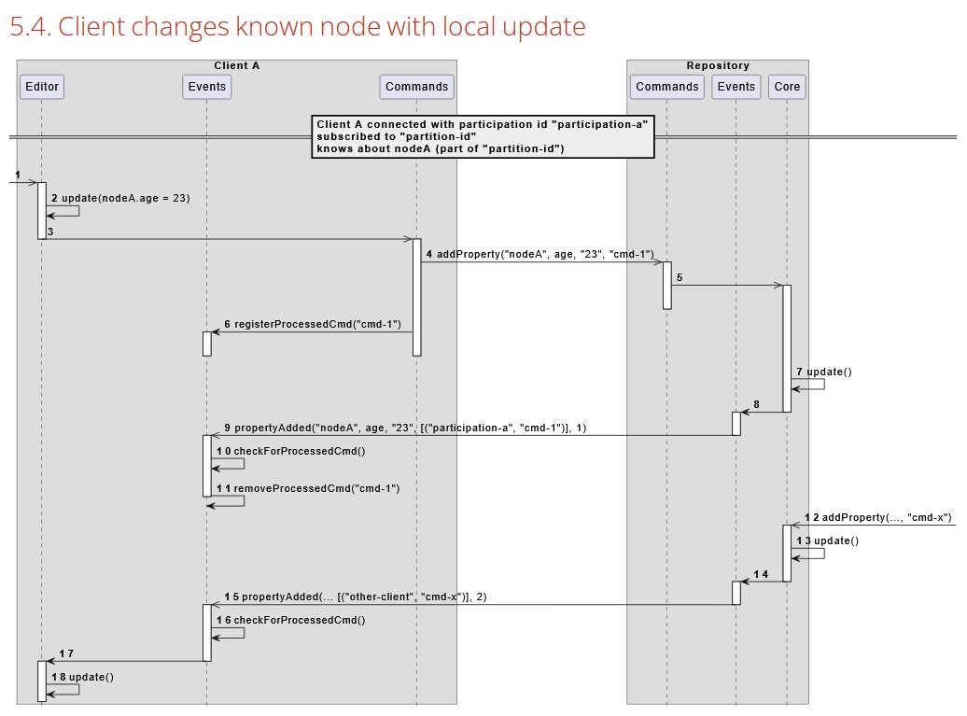
Well documented

Slide 15
Demo
https://github.com/LionWeb-io/space-demo

Slide 16





Languages (M2)
Finding
PowerBudget
runCommandLineTool
space.languages.json
class-core-generator
LionWebGenerator
Finding.g.ts
Languages.Finding.g.cs
PowerBudget.g.ts
Languages.PowerBudget.g.cs

Slide 17
Instances (M1)
voyager1.instance.json
Repository
WebClient A
Loader
WebClient B
Validator

Slide 18
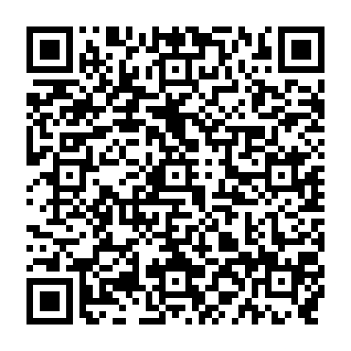
Team and Contact
Team
Meinte Boersma DSL Consultancy
Erkan Diken F1RE
Norman Koester itemis (Modelix)
Sergej Koscejev Freelancer
Sascha Lisson itemis (Modelix)
Pedro Molina Metadev
Eugen Schindler Canon Production Printing
Alex Shatalin JetBrains (MPS)
Niko Stotz F1RE
Federico Tomassetti Strumenta
Markus Voelter Freelancer
Ulyana Tikhonova F1RE
Jos Warmer Freelancer (Freon)
Want to work with us: GitHub: Web:
info@lionweb.io https://github.com/LionWeb-io https://lionweb.io/
Slack to follow us, use, or implement LionWeb:
https://join.slack.com/t/lionweb/shared_invite/zt-2k1k5bsv7-EvC2IABIgSxWrqJNVOZ0HQ
Contact

